Slide 1
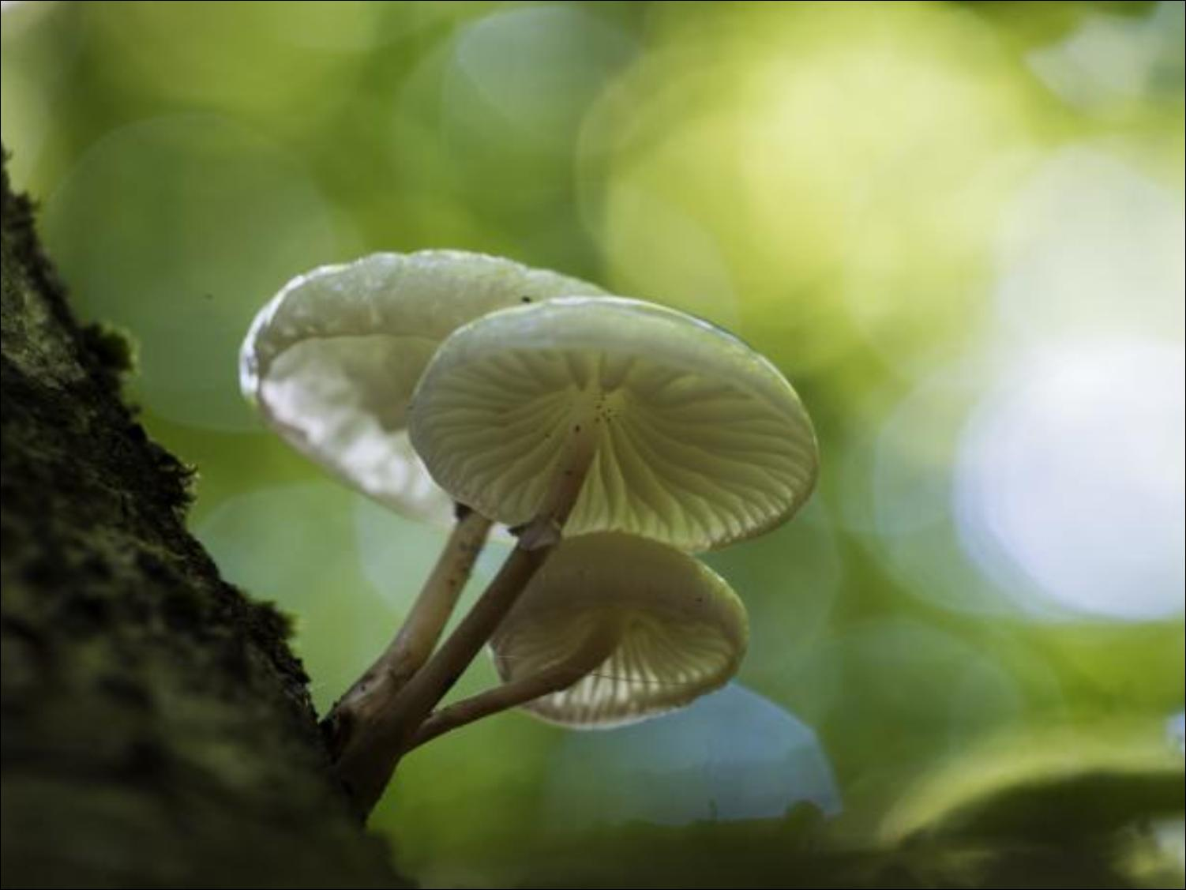
MUSHROOM AS A BIOREMEDIATION AGENT
SUBMITTED BY - AMRITA DAS
ROLL-VU/PG/MCB-IIS NO-0013
VIDYASAGAR UNIVERSITY

Slide 2
INTRODUCTION
The pollution of the environment with synthetic organic compounds has become a major problem world wide.
Artificially man made complex compounds i.e. Xenobiotics persist in environment and do not undergo biological transformation.
Chemicals like polycyclic aromatic hydrocarbons(PAH), polychlorinated biphenyls, pentachlorophenols, benzene, toluene etc have been targeted by United States Environmental Agency (USEPA) as priority pollutants due to their toxic effects on the environment and human health .
A rapid cost effective and ecologically responsible method of clean-up is “bioremediation” which utilizes micro-organisms to degrade toxic pollutants. Toxic chemicals are degraded to less harmful forms.

Slide 3
Mushroom forming fungi (mostly basidiomycetes), are amongst nature’s most powerful
decomposers, secreting strong extra cellular enzymes due to their aggressive growth
and biomass production. These enzymes include cellulases , ligninase peroxidases (LiP),
manganese peroxidase (MnP) and laccase, etc.
White rot fungi have been used for biotransformation of pesticides, degradation of
petroleum hydrocarbons and lignocellulolytic wastes in the pulp and paper industry.
Phanerochaete chrysosporium, Agaricus bisporus, Trametes versicolor and Pleurotus
ostreatus amongst many mushrooms have been reported in the decontamination
of polluted sites.

Slide 4
MUSHROOM AS A MYCOREMEDIATION TOOL
Remediation through fungi is also called as mycoremediation.
Mycoremediation tool refers to mushrooms and their enzymes due to having ability to degrade a wide variety of environmental pollutants, transform industrial and agro-industrial wastes into products.
Mushroom uses different methods to decontaminate polluted spots and stimulate the environment. These methods include –
(a) Biodegradation.
(b) Biosorption.
(c) Bioconversion.

Slide 5
BIODEGRADATION
Microorganisms
Secretion of Extracellular enzymes
Adherence of the enzyme to the polymer surface
Cleavage of polymer chains
Biodegradation and Biomineralization
End products like CO2, H2O, NO3 etc are produced
Degradation abilities of some mushrooms are depicted below –
(a) Pleurotus ostreatus - Degrades oxo-biodergadable plastics. (da Luz et al.2013)
(b) Lentinula edodes - Degrades 2,4-dichlorophenol (Tsujiyama et al. 2013)
(c) Coriolus versicolor - Degrades PAH (Jang et al. 2009)
(d) Pleurotus pulmonarius - Degrades crude oil. (Olusola and Anslem2010)

Slide 6
BIOSORPTION
Microorganisms
Biosorption mechanism Bioaccumulation mechanism
Passive process Active process
Dead and living biomass Living biomass
Removal of pollutants by biomass of mushroom through biosorption process –
Agaricus bisporous,Lactarius piperatus- Removes Cadmium(II) ions. (Nagy et al.2013)
Fomes faciatus - Removes Copper(II). (Sutherland and Venkobachar 2013)
Pleurotus platypus, Agaricus bisporus, Calocybe indica – Rmoves Copper, Zinc, Iron, Cadmium, Lead, Nickle. (Lamrood and Ralegankar 2013)
Pleurotus tuber- regium – Removes Heavy metals. (Oyetayo et al. 2012)

Slide 7
BIOCONVERSION
Lignocellulosic Biomass
Biological pretreatment
by White Rot Fungi
Pretreated biomass Liquefaction and Sugar Estimation(C5 / C6)
Saccharification
Fermentation by Yeast
Product Recovery
Bioconversion of waste by some Mushroom species –
Pleurotus citrinopileatus - Handmade paper and cardboard industrial waste. (Kulshreshtha et al. 2013)
Pleurotus ostreatus - Extract from the sawdust.(Akinyele et al. 2012)

Slide 8
MUSHROOMS AND BIOREMEDIATION
Mushrooms with other fungi are presently only organisms that can synthesize and excrete the relevant hydrolytic and oxidative enzymes that enable them to degrade organic substrates into soluble substances, which can then be absorbed by mushrooms for their nutrients.
White-rot fungi (WRF) are so called because their degradation processes result in a bleaching of wood substrates (8).
The common feature of white-rot fungi is their extensive degradation capability for lignin resulting in a bleached appearance of the rotten wood.
White rot fungi can depolymerise all the organic solid wastes, major wood components such as cellulose, hemicelluloses and lignin.

Slide 9
Lignin decomposing white-rot fungi show extraordinary abilities to transform
recalcitrant pollutants like polycyclic aromatic hydrocarbons (PAH’s) .
White-rot fungi have been used in bioremediation of polluted soils and bioaccumulation of heavy metals. They have also been found to be involved in mineralization, bio-deterioration, biodegradation, transformation and co-metabolism.
WRF comprise numerous fungi, mostly basidiomycota, including Coriolus versicolor, Dichomitus squalens, Lentinus edodes, Phlebia radiata, Panus tigrinus, Pleurotus ostreatus and Pycnoporus cinnabarinus, and a few species of ascomycota such as Xylaria spp.

Slide 10
WHITE-ROT FUNGI DEGRADATION SYSTEM
The main mechanism of biodegradation employed by this group of fungi is the lignin degradation system of enzymes. Extra-cellular lignin modifying enzymes (LME’s) have very low substrates-specificity so they are able to mineralize a wide range of highly recalcitrant organopollutants that are structurally similar to lignin (9).
The major components of lignin degradation system include lignin peroxidase (LiP), manganese peroxidase (MnP), H2O2 producing enzymes (7) and laccase.
It has been demonstrated that a lot of species belonging to the group of white-rot fungi are able to degrade lignin, which is a naturally occurring polymer (5).
This capacity is assumed to result from the activities of extracellular oxidases and laccases (4).

Slide 11
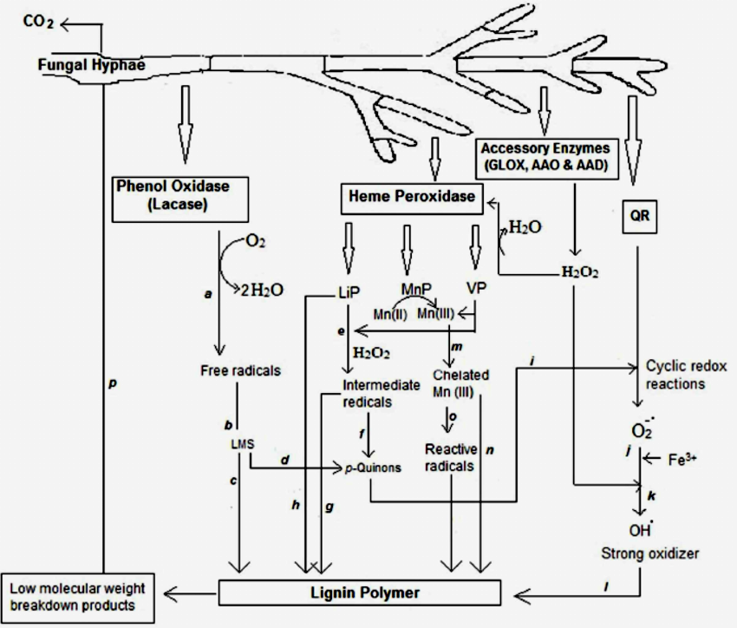

Fig- A Schematic presentation of lignin biodegradation process in white rot fungi.

Slide 12
Substrate oxidation via reduction of dioxygen into 2 molecules of water leading to
formation of free radicals.
Free radicals act as intermediate substrates for the enzymes (LMS).
Formation of mediators that can leave the enzymatic site and undergo non enzymatic
reactions of oxidative polymerization or depolymerization of lignin polymer.
(d) LMS involve in ligninolysis.
Formation of intermediate radicals, such as phenoxy radicals and veratryl alcohol
radical cations via muli-step electron transfer reaction.
Cα-Cβbreakdown yielding p-quinones.
Repolymerization.
Direct oxidation of non-phenolic aromatic substrates by LiP.
Oxygen activation in redox cycling reactions involving QR.
Reduction of the ferric iron
Reoxidation of reduced ferric iron by reduction of H2O2 and release of hydroxyl free
radical (OH˙).
(l) OH˙ initiates the attack on lignin.
(m) Oxidation of Mn(II) to Mn(III) which is then chelated by oxalate or other chelators.

Slide 13
(n) Chelated Mn(III) complex acts as a reactive low molecular weight, diffusible redox-
mediator for oxidation of phenolic substrate.
(o) Formation of reactive radicals in the presence of a second mediator (such as -
acetic acid radicals, peroxyl radicals, superoxide and formate radicals) for
oxidation of non phenolic substrate.
Finally the low molecular weight compounds are subsequently taken up by fungal
hyphae and converted to CO2.
[Abbreviations: LMS – Laccase Mediate System; LiP -
Lignin Peroxidase; MnP - Manganese Peroxidase; VP – Versatile Peroxidase; GL0X–
Glyoxal Peroxidase; AAO– Aryl Alcohol Oxidase;AAD– Aryl Alcohol Dehydrogenase;
QR – Quinone Reductase; OH˙ - Free Hydroxyl Radical].(10)

Slide 14
Biodegradation of polyester polyurethane by Aspergillus tubingensis
Polyurethane is a plastic material, which exists in various forms and used in various application such as manufacturing of tyres, gaskets, bumpers, ﬁbers, plastic foam, synthetic leathers, jackets, adhesive, etc. all of which lack degradability.
PU biodegradation was tested in three different methods and the results showed that A. tubingensis could grow on the surface of PU film, and have biodegradation capabilities such as surface cracking, erosion, pore formation or loss in tensile strength. These physical and chemical changes were observed by SEM and ATR-FTIR analyses. The whole biodegradation process was completed in three steps as attachment or adhesion of the fungus to the surface of PU film, hyphal growth and propagation on the surface of PU, and secretion of PU degrading enzymes (esterases and lipases).
(Khan, S., et al., Biodegradation of polyester polyurethane by Aspergillus tubingensis, Environmental Pollution 2017, http://dx.doi.org/10.1016/j.envpol.2017.03.012)

Slide 15
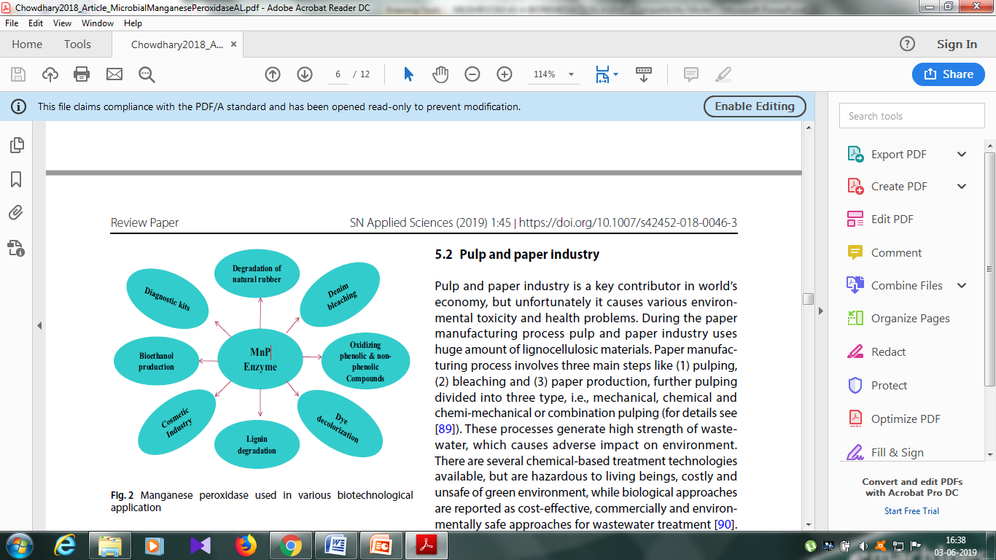
AMPLE APLICATIONS OR OPPORTUNITIES OF MANGANESE PEROXIDE (MnP)
Fig- MnP used in various Biotechnological application

Slide 16
POTENTIALS OF MUSHROOMS IN BIOREMEDIATION
Phanerochaete chrysosporium –
P. chrysosporium degrades lignin macro molecules, organopollutants such as polycyclic aromatic hydrocarbons (PAH’s), and dioxines, synthetic dyes, pesticides etc.
Produce ligninase,the extracellular enzyme which deploymerize lignin, and lignin sub-structured compounds in vitro (1).
It has degraded aromatic hydrocarbons, chlorination organics, insecticides, pesticides, and laccases; polyphenol oxidases and lignin peroxidases being involved in the degradation process (2).
Pleurotus ostreatus --
P. ostreatus is able to degrade a variety of polycyclic aromatic hydrocarbons(PAH)
(Sackand Gunthen, 1993). It has the ability to degrade PAH in non-sterile soil both in
the presence and in the absence of cadmium and mercury.

Slide 17
Trametes versicolor --
T. versicolor produced three lignolytic enzymes with efficient degradation capacity on lignin, polycyclic aromatic hydrocarbons, polychlorinated biphenyl mixture and a number of synthetic dyes (12).
Its enzymes have been reported to delignify and to bleach kraft pulp (4) and also efficiently dechlorinate and decolorize bleach kraft pulp effluents (11).
Use of T. versicolor as biocatalysts for decolorization of different industrial dyes and
waste water treatments. (2)
Lentinula edodes –
Produces two extracellular enzymes (manganese peroxide and laccase).
Pleurotus pulmonarius var. stechangiia(an oyster mushroom)-
It can excrete both kinds of cellulose and lignin-degrading enzymes.

Slide 18
CONCLUSION
Mushroom is a tremendous boon to the idea of using this for mycoremediation process as a real-world solution. Its a very good approach and solution towards economical and ecologically sound method of environmental remediation. The cultivation of edible mushroom on agricultural and industrial wastes may thus be a value added process capable of converting these discharges, which are otherwise considered to be wastes, into foods and feeds. Despite of significant research efforts mycoremediation is still an emerging technology. More intensive research needs to be carried out on the potentials of bioremediation and ecology of a large
number of edible mushrooms effective for bioremediation.

Slide 19
FUTURE ASPECTS
Biodegradation efficiency of White Rot Fungi can be further enhanced.
The metal uptake potential of mushrooms should be critically analyzed for health risk as mushrooms have become a popular delicacy of modern world. Further information is needed about the level of toxicity in these mushrooms, ignorance of which will cause the health problems.

Slide 20
REFERENCES
Aitken MB, Irvine RL (1989). Stability testing of ligninase and Mn peroxidase from Phanerochaete chrysosporium. Biotech. Bioengr. 34:1251-1260.
Amaral PFF, Fernandes LAFD, Tavares APM, Xavier AMR, Cammarota MC, Coutinho JAP, Coelho MAZ (2004). Decolorization of dyes from textile wastewater by Trametes versicolor. Environ. Technol. 25(11):1313-1320.
Barr BP, Aust D (1994). Mechanisms of white-rot fungi use to degrade pollutant. Environ. Sci. Technol. 28:78-87.
Gamelas JAF, Tavares APM, Evtuguin DV, Xavier MRB (2005). Oxygen bleaching of Kraft pulp with polyoxometaltes and laccase applying a novel multi-stage process. J. Mol.Catal|Ysis B: Enzymatic 33(3-6):57-64.
Glenn JK, Gold MH (1983). Decolorization of several polymeric dyes by the lignin degrading basidiomycetes Phanerochaete chrysosporium. Appl. Environ. Microbiol. 45:1741-1747.
Hattaka A (1994). Lignin–modifying enzymes for selected white rot fungi production and mode in lignin degradation. Microbiol. Rev. 13:125- 135.
Kirk TK, Farrell RL (1987). Enzymatic combination – microbial degradation of lignin. Annu. Rev. Microbiol. 41:465-505.
kirk TK, Lamar RT, Glaser JA (1992). Potential of white-rot fungi in bioremediation. Biotechnol. Environ. Sci. Mol. Appl. pp. 131-138.

Slide 21
.
Mansur M, Arias ME, Copa-Patino JL, Flardh M, Gonzalez AE (2003). The white rot fungus Pleurotus ostreatus secretes laccase isozymes with different substrate specificites. Mycologia 95(6):1013-20.
Paliwal, R., Rawat, A. P., Rawat, M., & Rai, J. P. N. (2012). Bioligninolysis: Recent Updates for Biotechnological Solution. Applied Biochemistry and Biotechnology, 167(7), 1865–1889. doi:10.1007/s12010-012-9735-3 PMID:22639362
Selvam K, Swaminathan K, Song MH, Chae KS (2002).Biological treatment of pulp and paper industry effluent by Fomes lividus and Trametes versicolor. World J. Microbiol. Biotechnol. 18(6):523-526.
Tanaka H, Itakura S, Enoki A (1999). Hydroxyl radical generation by an extracellular low- molecular–weight substance and phenol oxidase activities during wood degradation by the white–rot basidiomycetes Trametes versicolor. J. Biotechnol. 75(1):57-70.
13. Verdin AA, Sahraoui L-HR, Durand R (2004). Degradation of benzo(a)pyrene by mitosporic fungi and extracellular oxidative enzymes. Int. Biodeterior. Biodegr. 53:65-70.

Slide 22


